Slide 1
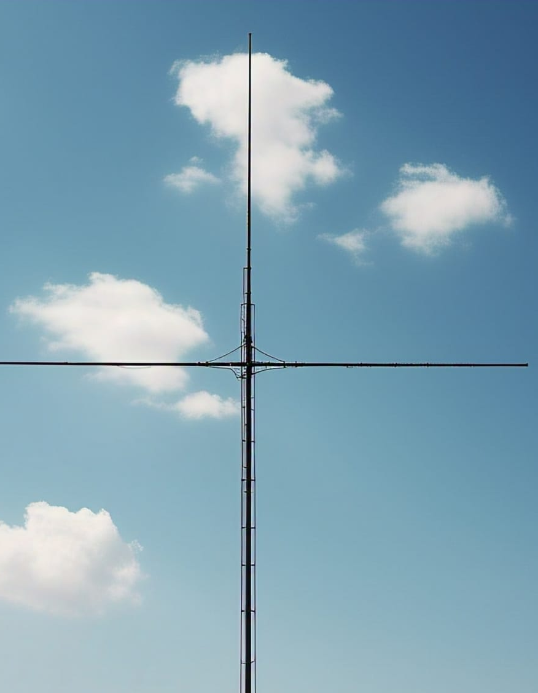
DIPOLE ANTENNA
​

Slide 2
Agenda
1
2
3
4
5
Introduction
Types of Dipole Antenna
Characteristics
Design Specification
Applications

Slide 3

Introduction
A dipole antenna is a type of radio antenna that consists of two identical conductive elements, such as wires or rods, that are separated by a small gap. The dipole antenna works on the principle of electromagnetic induction, where an alternating current (AC) flowing through the conductive elements creates a magnetic field, which in turn induces an electric field.

Slide 4
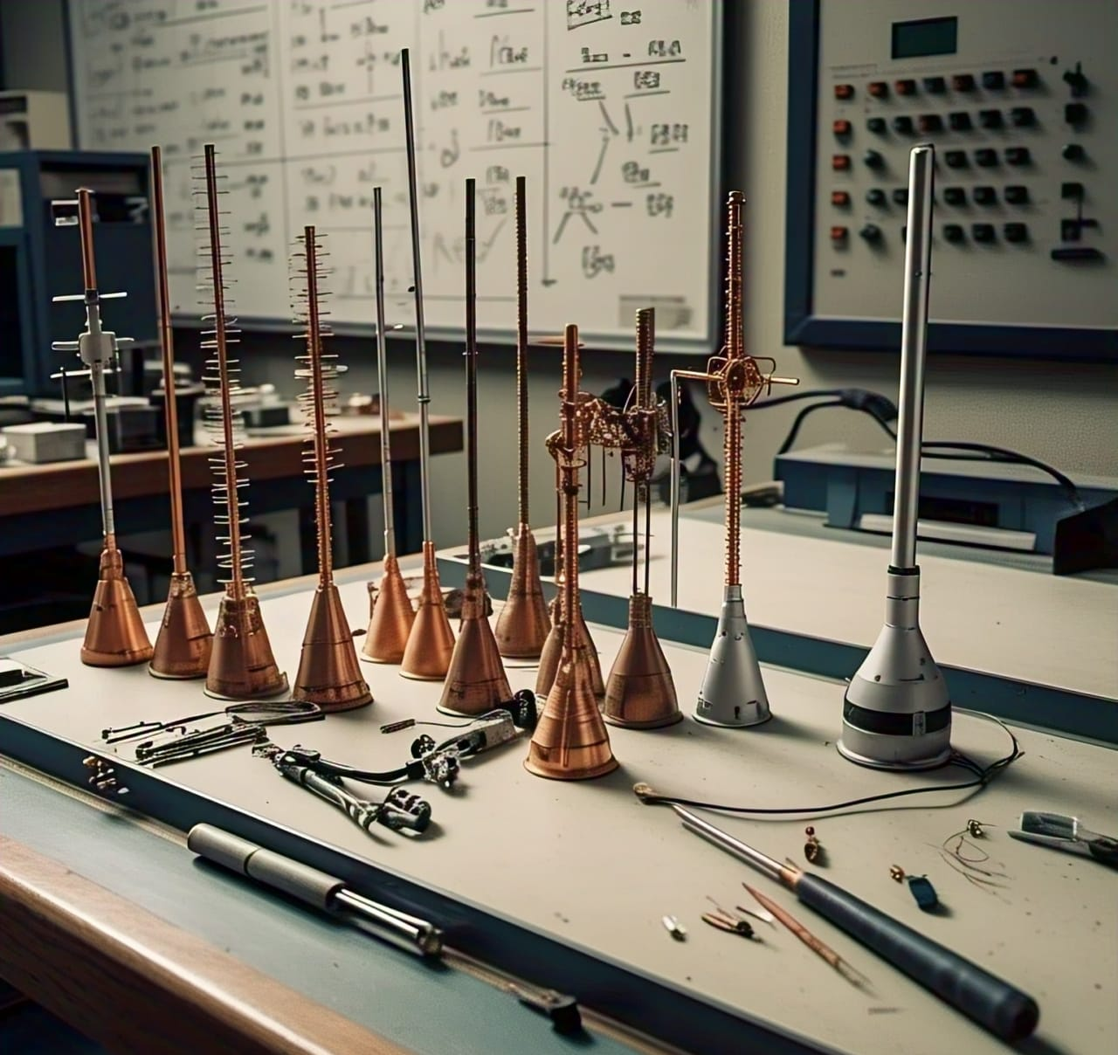
Types of Dipole Antenna
Folded Dipole Antenna
Quarter-Wave Dipole Antenna
Simple Dipole Antenna
Half-Wave Dipole Antenna

Slide 5
TYPES OF DIPOLE ANTENNA
1.Folded Dipole Antenna
A folded dipole antenna is a type of dipole antenna where the two elements are folded together to form a single element. Higher impedance (about 300Ω), making it suitable for impedance matching.
2.Quarter-Wave Dipole Antenna
A quarter-wave dipole antenna is a type of dipole antenna where the length of each element is a quarter of the wavelength of the signal being transmitted . Requires a ground plane for proper operation.
Length: λ/4
3.Simple Dipole Antenna
A simple dipole antenna consists of two identical conductive elements, such as wires or rods, that are separated by a small gap.
4.Half-Wave Dipole Antenna
A half-wave dipole antenna is a type of dipole antenna where the length of each element is half the wavelength of the signal being transmitted.
Length: λ/2 (half of the wavelength)

Slide 6
Characteristics
1.Simple design:
Dipole antennas have a simple design, making them easy to manufacture and maintain.
2. Omnidirectional radiation pattern:
Dipole antennas radiate energy equally in all directions, making them suitable for applications where coverage is needed in all directions.
3. Resonant frequency:
Dipole antennas have a resonant frequency, which is the frequency at which the antenna is most efficient.
4. Bandwidth:
Dipole antennas have a relatively narrow bandwidth, which means they are most effective over a limited range of frequencies.
5. Polarization:
Dipole antennas are linearly polarized, meaning they transmit and receive signals with a specific orientation.

Slide 7
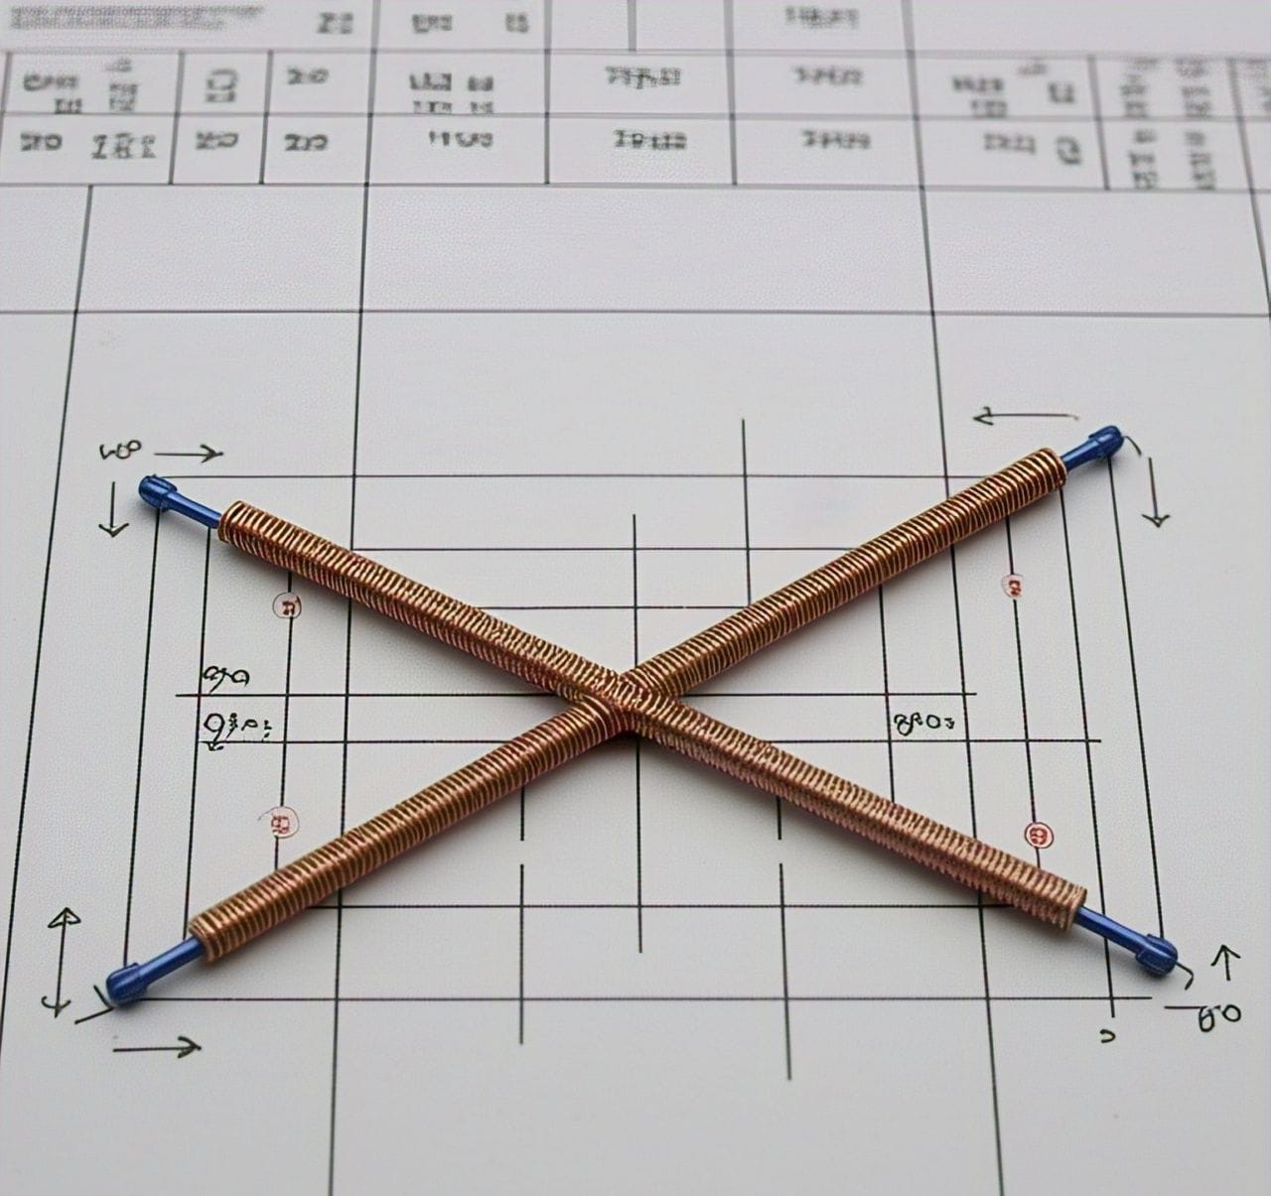
Design specifications
Electrical Specifications
Frequency Range:2.40404GHz
Impedance: 50 ohms
Bandwidth: 10% to 20% of the center frequency
Gain: 0-1.75dB
VSWR: 2.415GHz
Length: 0.059
Radiation Pattern: Omnidirectional in the azimuth plane
Polarization: Linear (horizontal or vertical)
Radiation Pattern
Azimuthal Pattern: The azimuthal pattern of a dipole antenna is typically a figure-eight pattern with maximum radiation perpendicular to the antenna axis.
Elevation Pattern: The elevation pattern of a dipole antenna is typically a doughnut-shaped pattern with maximum radiation in the horizontal plane.

Slide 8
Applications
Radio broadcasting
To transmit signals to a wide area.
Radar systems
To detect and track objects.
Satellite Communication
To transmit and receive signals.
Wireless
Communication
For cellular networks and Wi-Fi.
Television broadcasting
To transmit signals to a wide area.

Slide 9

Thank you
NAME : P.Sumanth
REG.NO: 9922005061

